Slide 1

“Cell cycle analysis based on scRNA-seq data”
“ “Fast” cell cycle for ESC and some cancers”
Alexander Chervov , Andrei Zinovyev et.al.
(Computational Biology group, Curie)

Slide 2
Part 1. Introduction.
Generalities on cell cycle

Slide 3
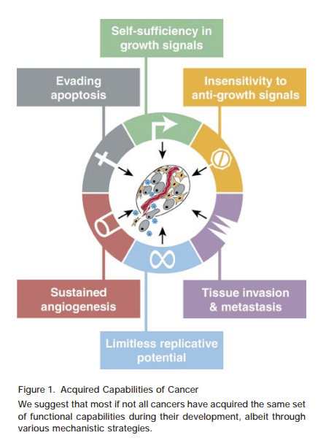
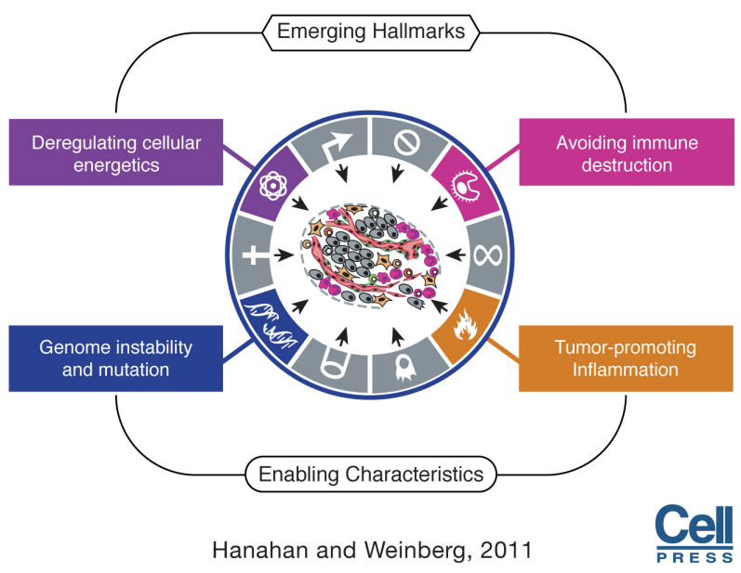
Aberrant proliferation is one of the hallmarks of the cancer
2000 Hanahan Weinberg

Slide 4
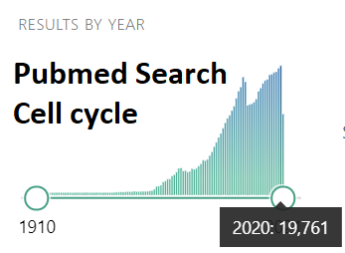
Active research
What we know and want to know more:
Cyclins and cyclin-dependent kinases are key regulators of the cc (Nobel prize 2001)
Near 20 000 papers per year “on cell cycle”
1000-4000 genes reported to be cc related (lncRNA, miRNA)
Drugs like CDK4/6 inhibitors target cell cycle machinery and many other activating signaling (receptors and kinases)
Cell type dependence and some deviations from the classical cell cycle scheme were reported
Understanding cell cycle mechanisms is actively ongoing

Slide 5
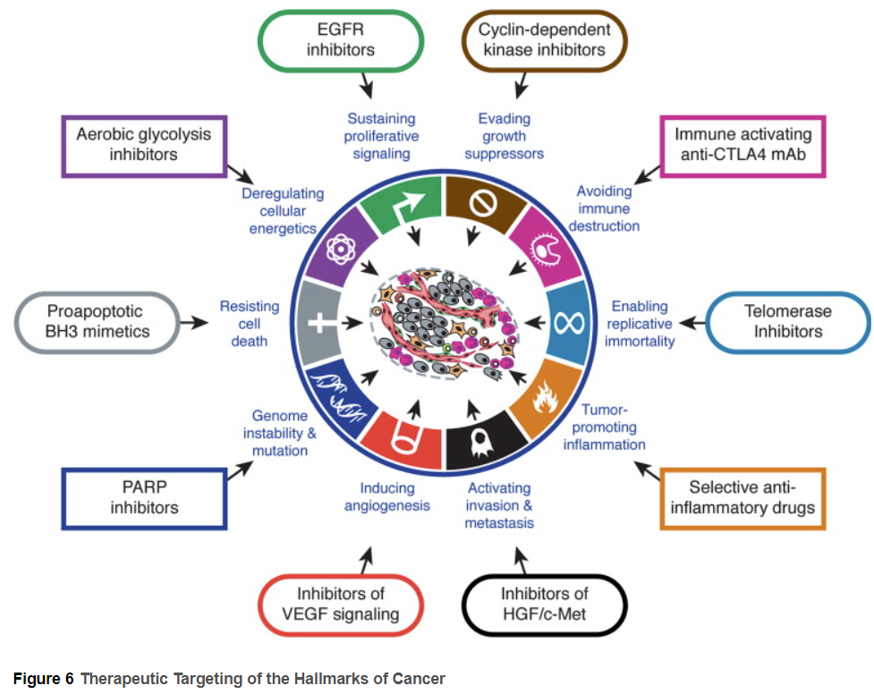
Many anti-cancer drugs target proliferating related targets:
EGFR inhibitors,
CDK inhibitors
Etc
From “Hallmarks -2” (2011)

Slide 6
Methods to study cell cycle (transcriptome based)
Bulk 1998-
Bulk scRNA-seq technique to study cc:
Synchronize cells in one phase of cc
Every say 30 minutes take part of cells and sequence it
Advantage: high time resolution (N-minutes), low cost
Disadvantage: loss of synchronization after a while
Single cell 2015-
Single cell RNA-seq technique to study cc:
Just do sequencing
NO timestamps !
Computationally infer “pseudotime” (that is the main challenge - sometimes it is easy, sometimes seems to be impossible)
Advantage: thousands publically available datasets - (any data, not specially designed for cc study)
Disadvantage: high time resolution is not achievable yet , high cost

Slide 7
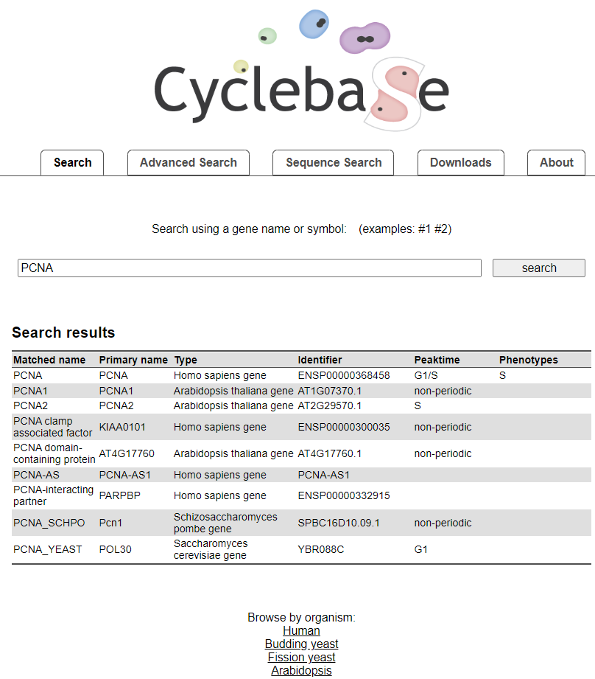
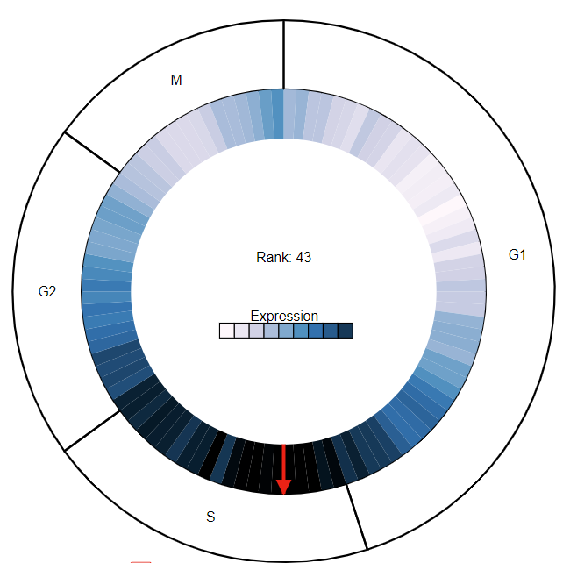
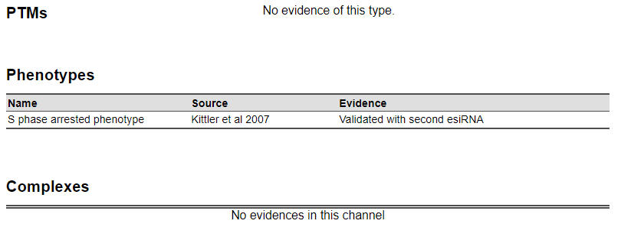
Cyclebase site - summarize several bulk studies
https://cyclebase.org/CyclebaseSearch

Slide 8
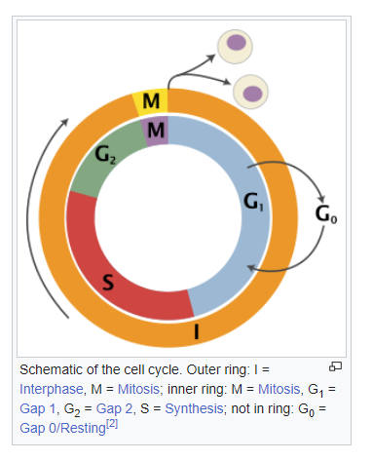
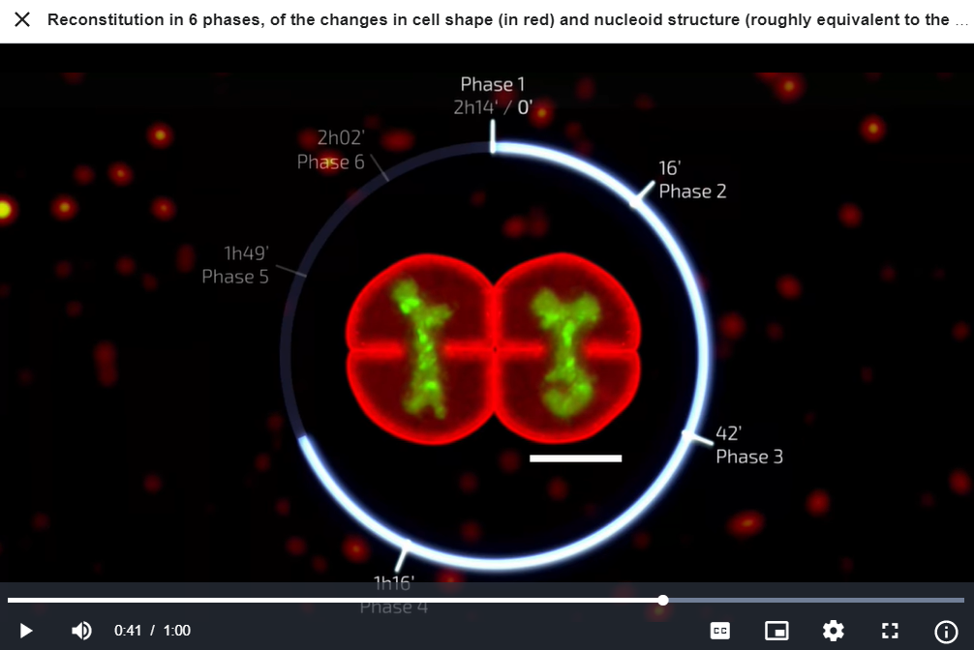
Cell cycle basics - phases
S-phase (Synthesis) - DNA duplication, G1,G2 - “Gap” phases (Growth and preparations),
https://en.wikipedia.org/wiki/Cell_cycle

Slide 9
Part 2.1 scRNA-seq and cell cycle
“Standard cell cycle”

Slide 10
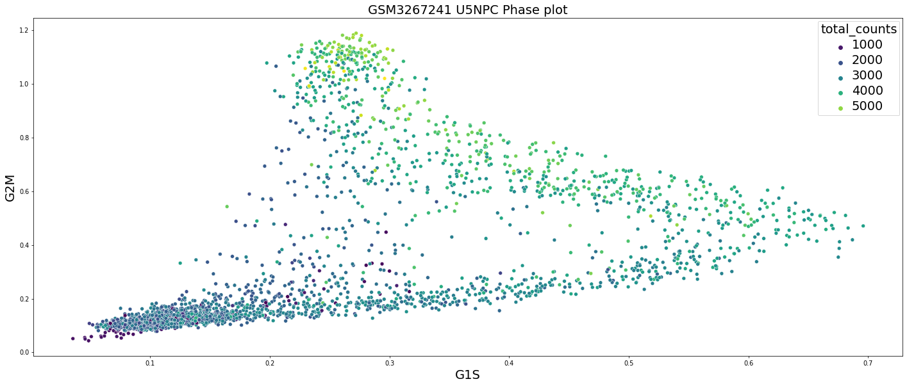
scRNA seq and cell cycle - first computational goals
Input data:
count matrix - cells x genes (no timestamps, not cell cycle phase markers)
Computational goals:
Are there proliferating cells at all ?
For each cell determine the cell cycle phase
Cell cycle pseudotime (i.e how far a cell is from mitosis)
What genes are involved in cell cycle and characterize their changing along the cell cycle (further understand the regulation - transcriptional factors etc.)
In some cases - “remove the cell cycle signal”, i.e. not better see other differences in cells we might what to computationally change the transcriptome as if all the cells at the same cell cycle position.
Notes:
https://www.kaggle.com/code/alexandervc/cell-cycle-2-genes-expressions-plots?scriptVersionId=76408018

Slide 11
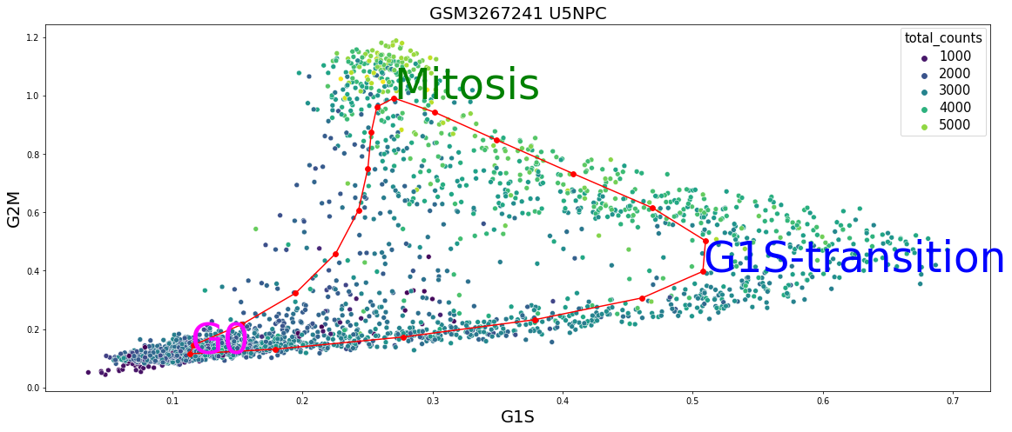
Message 1: in some cases it can be easily done
For:
1) the high quality data (and many cells),
2) with no much batch effects
3) … of course, there exceptions
There is an approach where you can see resolve first questions quite in a simple and visually interpretable way: G1S/G2M plot from Tirosh et.al.
Notes:
https://www.kaggle.com/code/alexandervc/cell-cycle-2-genes-expressions-plots?scriptVersionId=76408018&cellId=22

Slide 12
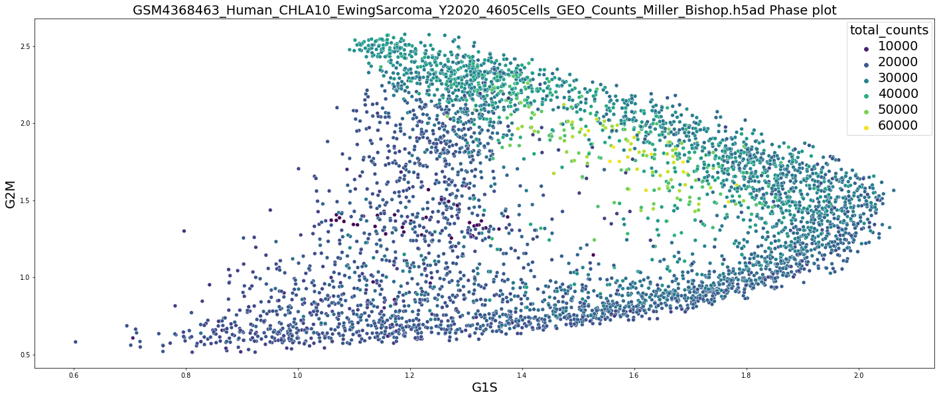
Tirosh G1S/G2M “phase” plot (from Regev lab papers ~2015-16), simple, but powerful. Same construction for any data, highly interpretable:
Two sets of genes: “G1/S peaking”; “G2/M peaking”
(Clever choice of those 50+50 genes out of the thousand which work pretty stable for most datasets)
For each cell calculate averages over these groups of genes
Got two numbers for each cell, plot a point with these coordinates
It works for many cases, but not for all - see discussion below.

Slide 13
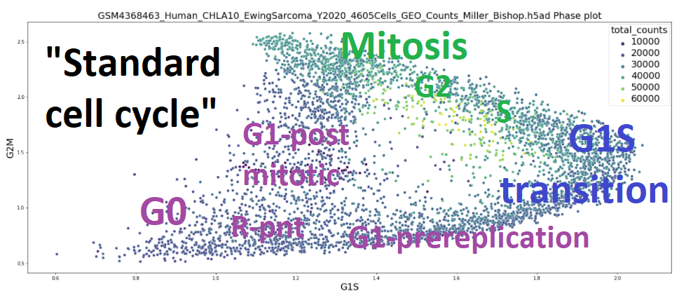
Interpretability:
G0 - (quiescence phase) - slogan to remember “G0-near zero” - easy to expect/explain cause cell cycle genes are low expressed - so should not be proliferation
Mitosis - always on the top part of the figures - because y-axis combines the genes which are top in Mitosis (Cyclin A,B)
Transition from G1 to S-phase is clearly seen as turning point of trajectory - G1S genes for chosen like that
Mitosis well-known to be quite short, so not clearly separated from G2 on plot
After Mitosis cell is splitted in two parts so the number of transcripts should be reduced twice - that is seen for good quality datasets - total counts falls down after Mitosis
Less expected:
It really works (i.e. not spoiled by noise). And for may datasets (stability), you see the “hole” at the center - indiction of cyclic nature of the process
That implies that hundreds genes works in a bit unexpectedly synchronized manner - since we average many genes and see less noisy result
Figure is segmented (“triangle”), segments - partly correspond to (sub)-phases - correspond activation of powerful TF like E2F*
Travel along the cell cycle:
Starting at G0, mainly G1/S genes starts to grow. At transition point G1S, the other set of genes (G2/M) accelerates significantly while G1/S begin to fall.
After Mitosis cell goes to post-mitotic G1 where all cc-genes are going down. At Restriction point cell decides to go to G0 or to the next cell cycle (G1).

Slide 14
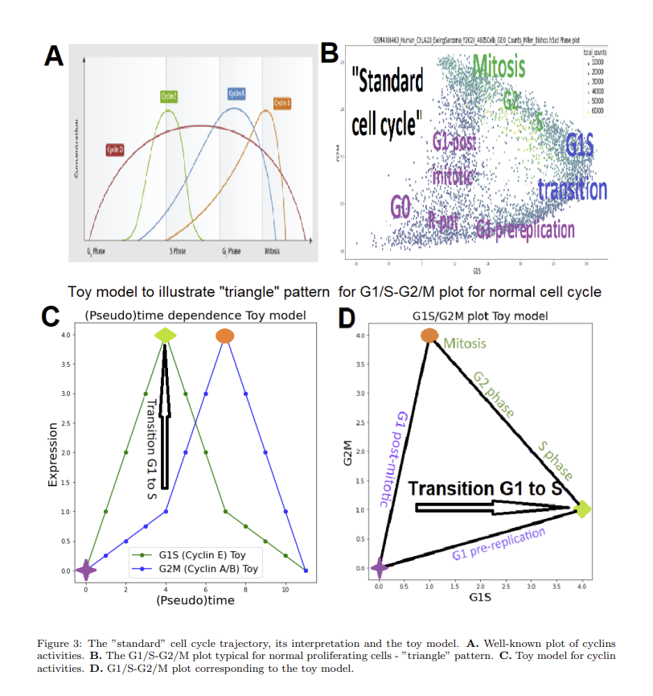
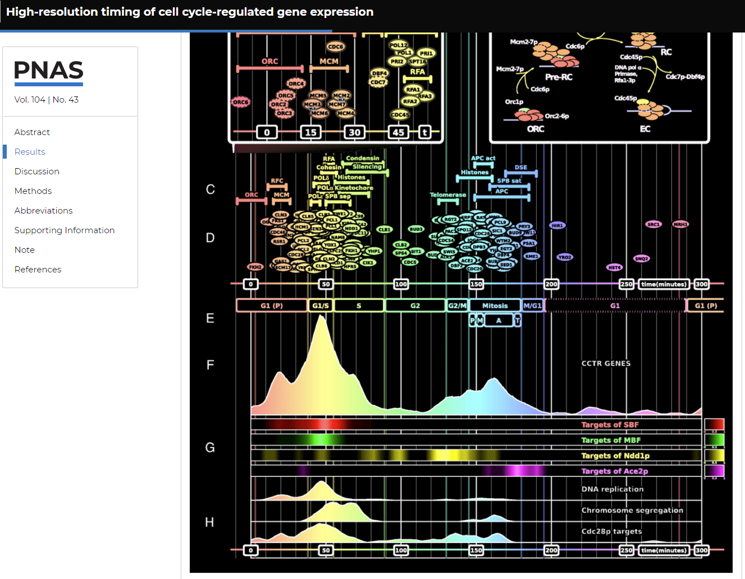
Explanation of the triangle
https://www.pnas.org/doi/full/10.1073/pnas.0706022104

Slide 15
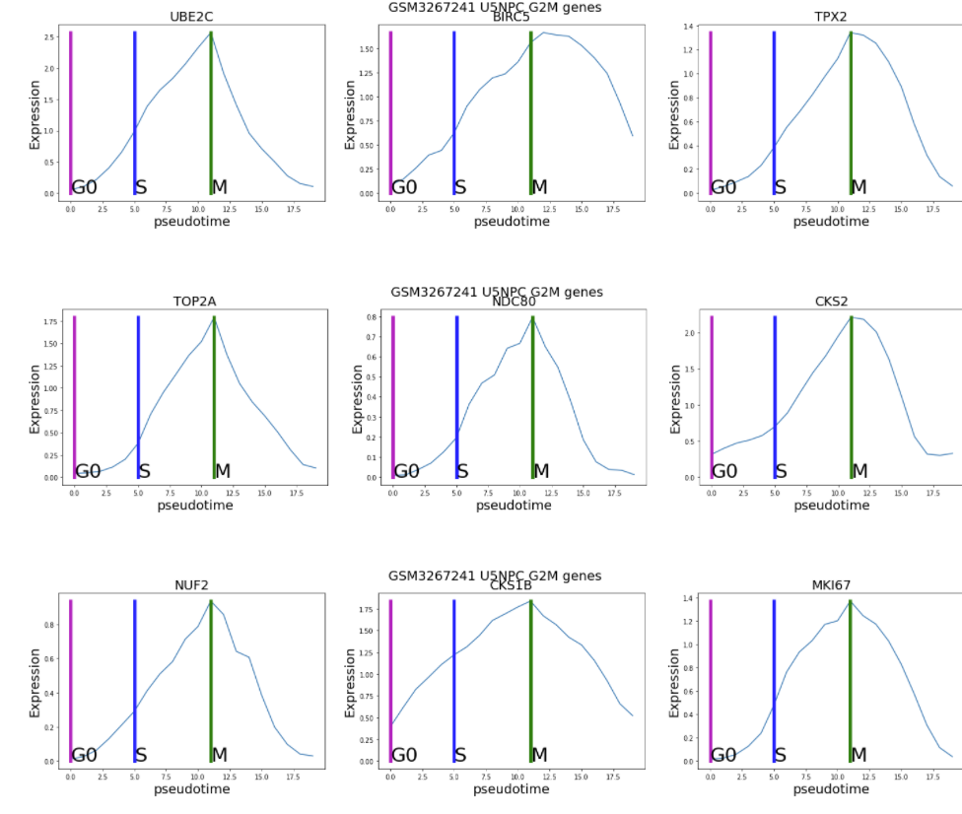
“G2M genes”
All peak near M-phase
Cyclin-B
Mostly targets of FOXM1 transcription factor
TOP2A, UBE2C, CENPA/F, KIF*, CDCA*,AURKB,
There are some differences HN1,LBR are not 0 at G0, etc
Notes:
https://www.kaggle.com/alexandervc/cell-cycle-2-genes-expressions-plots#Genes-plots-along-cell-cycle

Slide 16
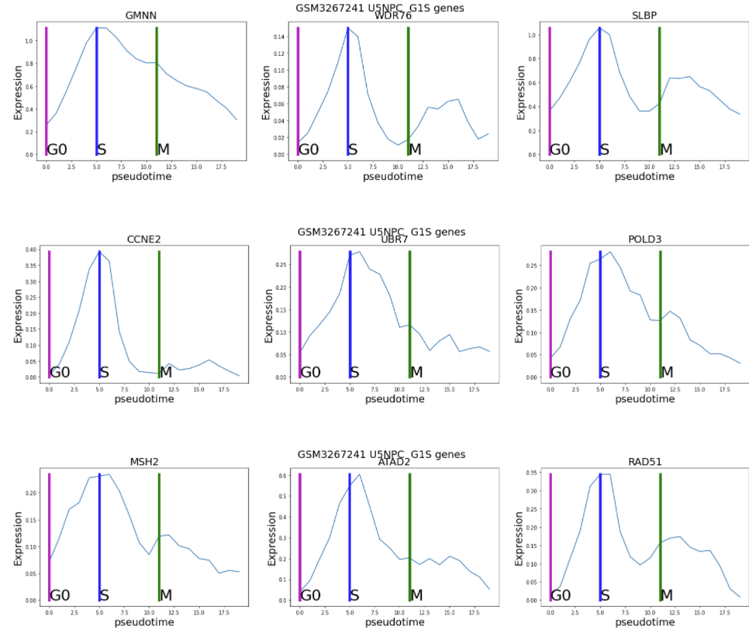
“G1S genes”
All peak at G1/S transition point. Almost all behave very similar.
Cyclins-E: CCNE1,CCNE2
Targets of the transcription factor E2F1
There are some differences: most like CCNE fall to 0 before G2, while others GMNN decrease quite much slowly
Notes:
https://www.kaggle.com/alexandervc/cell-cycle-2-genes-expressions-plots#Genes-plots-along-cell-cycle

Slide 17
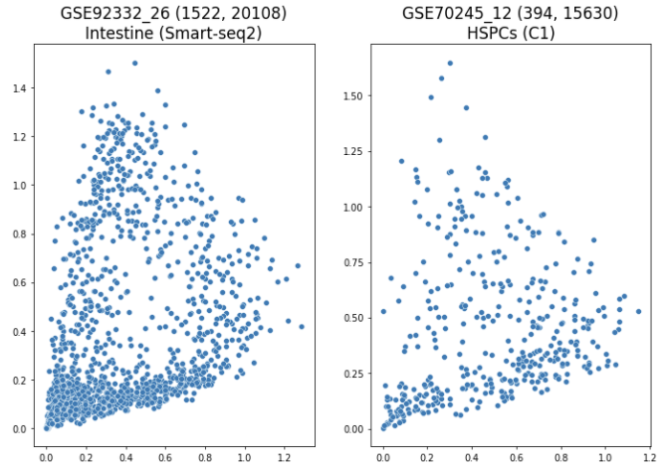
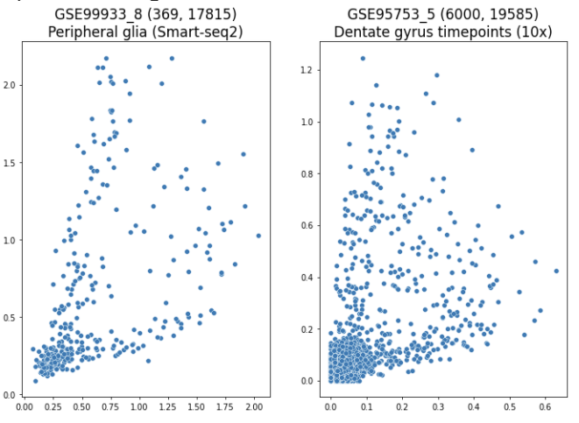
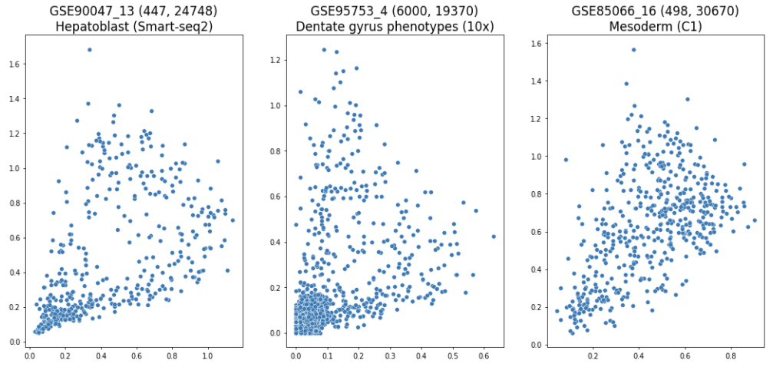
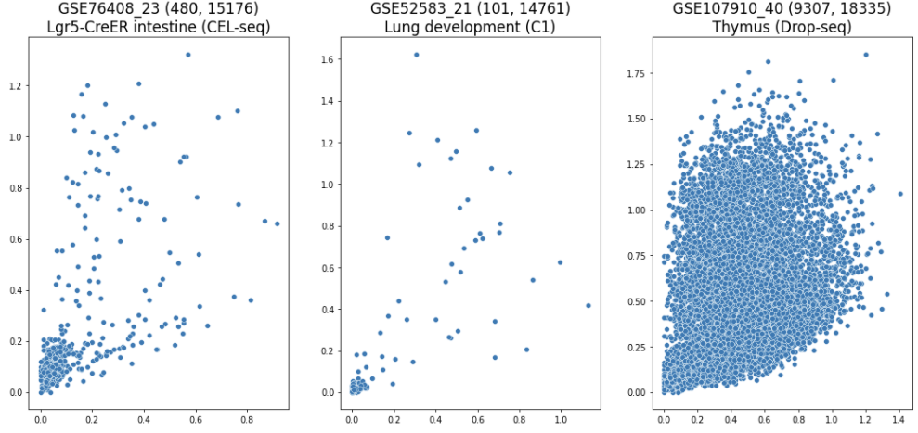
Notes:
From cytotrace collection
https://www.kaggle.com/alexandervc/cell-cycle-cytotrace-draft-1?scriptVersionId=73279459

Slide 18
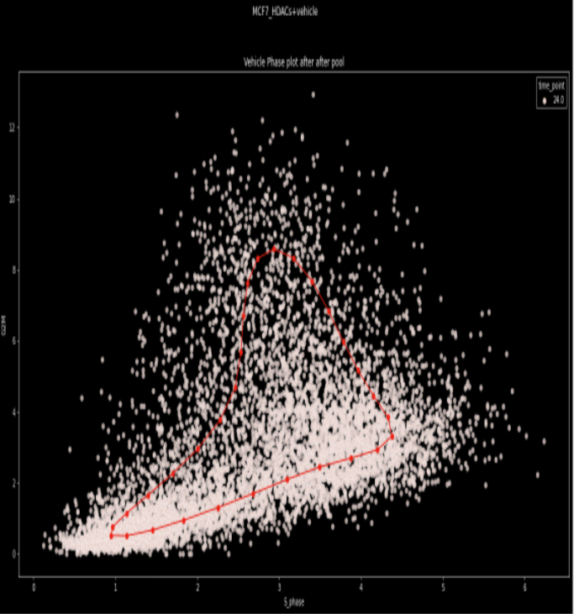
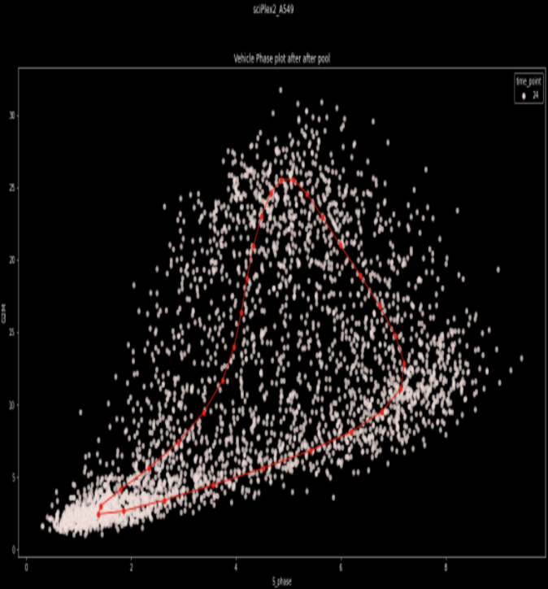
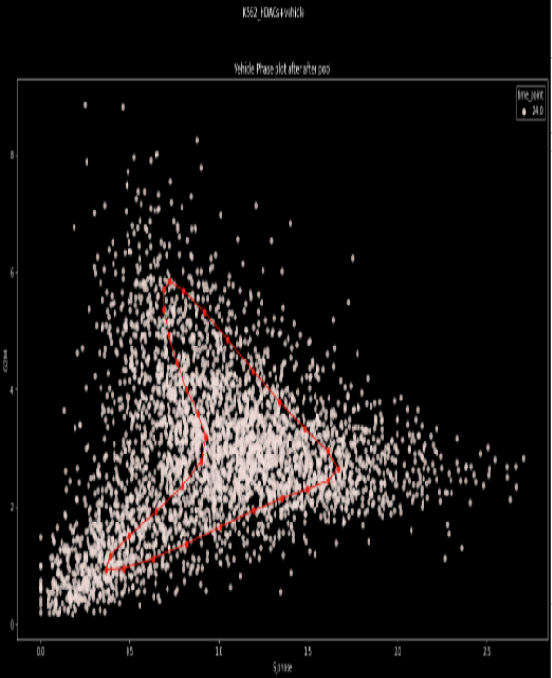
Single nucleus RNA sequencing >= 700 000 cells at once, but higher dropout, still “standard” cc - recognizable pattern. MCF7, A549, K562

Slide 19
Hints
Do not use UMAP,TSNE, any non-linear method for cell cycle analysis
Split the cell types and batches to get clearer picture
Do not use many cell cycle related genes in the analysis , just use only these 100 Tirosh genes.

Slide 20
Part 2.2 scRNA-seq and cell cycle
“Fast cell cycle”

Slide 21
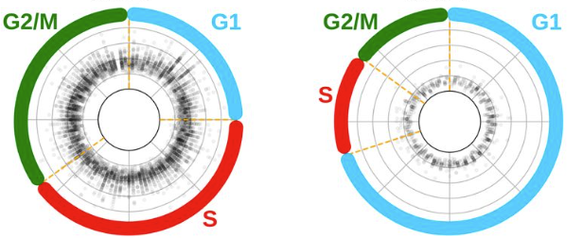
Context 1 - Reminder ESC cell cycles is “fast”
Despite the cell cycle is highly conservative among even eukaryotes, not just mammals or cells within one organism, some differences exists: It is well-known that cell cycle for Embryonic Stem Cells is slightly different.
Duration of the cell cycle for normal mammalian cells widely varies around 24 hours, for ESC around 12 hours
The claim is that “G1”-phase is shorter.
Other things known, but not completely
G1 for ESC is “shorter”

Slide 22
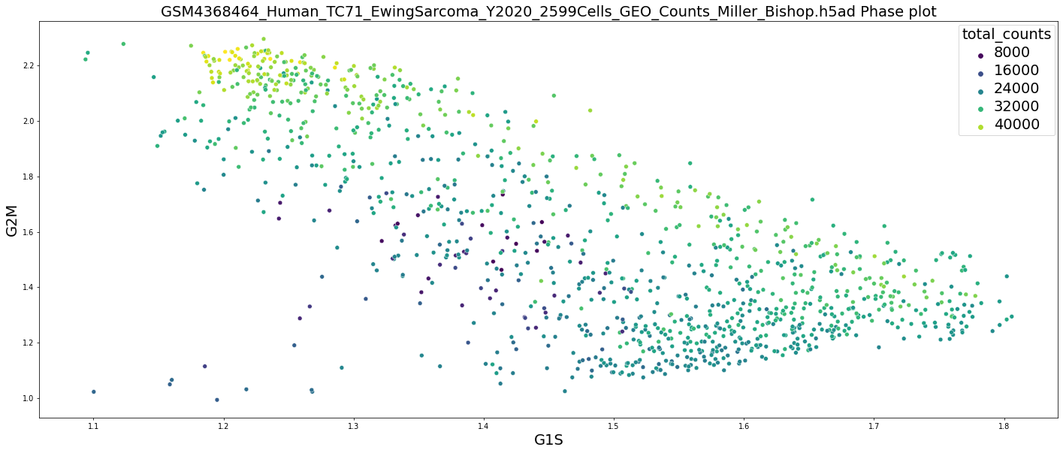
“Fast cell cycle”
“Phase” plot for some datasets looks different - anticorrellation G1S/G2M phases.
It is “fast” cell cycle pattern.
It is appears to be for cell types with small doubling time (25-30 hours): U2OS, TC71 etc. and some embryonic cell types (corresponds to well-known fact that embryonic cell has fast cell cycle).
H1-cell line (the first hESC established), its relative H9-cell line, LCL-derived iPSC, GSE117225 (burst forming unit erythroid), LT-NES SAI2 cell (GSE114670) etc.

Slide 23
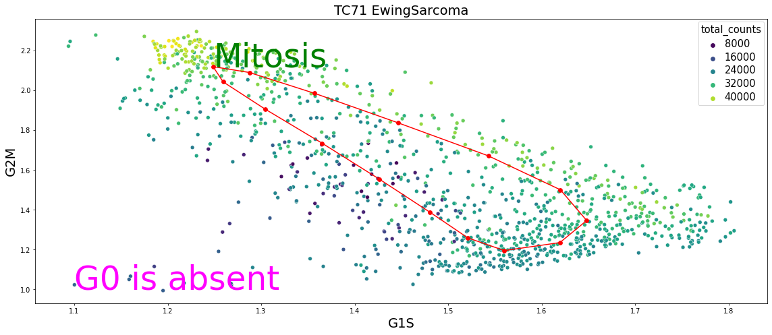
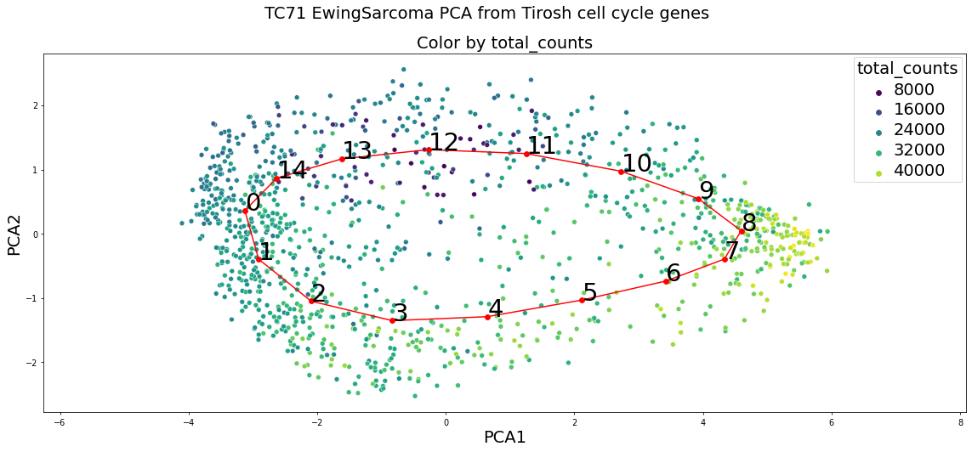
“Fast” cell cycle
Does not have G0 part and Restriction control point
G1 part is shortened comparing to standard, arguably post-mitotic G1-subphase disappears and immediately after Mitosis cells are committed to the next cell cycle.
The “cycle” (“hole”) is not clearly seen on phase plot, nevertheless it is again very useful to provide interpretations. One can visualize “cycle” using e.g. PCA (from the space of cell-cycle related genes).

Slide 24
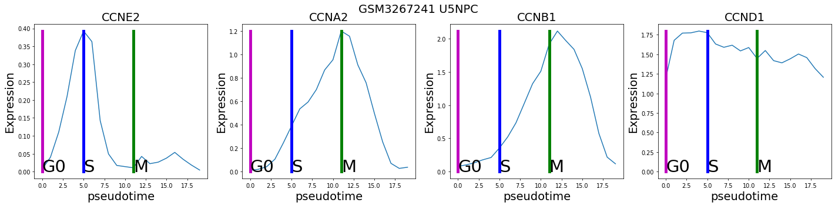
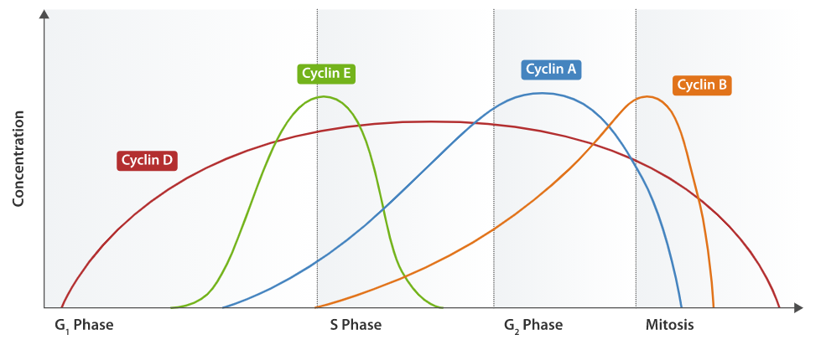
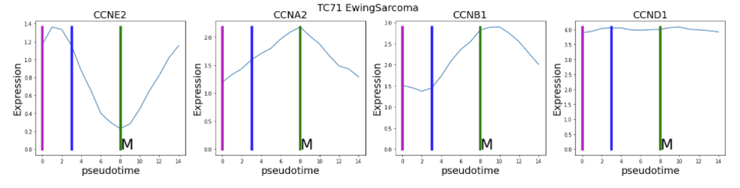
Gene here is no point where all cyclins achieve minimum (G0-like state) i.e. at any point either E or A/B cyclins are strongly expressed. So cell is in active proliferation mode - “fast” cell cycle

Slide 25
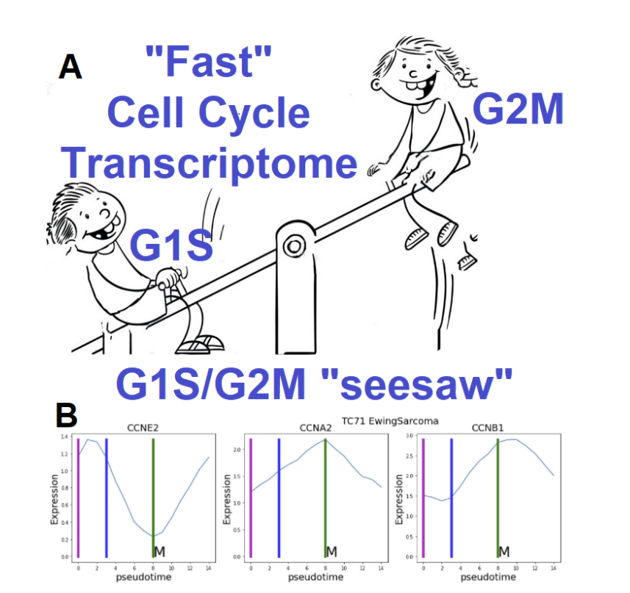

Slide 26
First claim: molecular characterizations of the fast cell cycle (scRNA-seq friendly). First characterization.
Gene here is no point where all cyclins achieve minimum (G0-like state) i.e. at any point either E or A/B cyclins are strongly expressed. So cell is in active proliferation mode - “fast” cell cycle

Slide 27
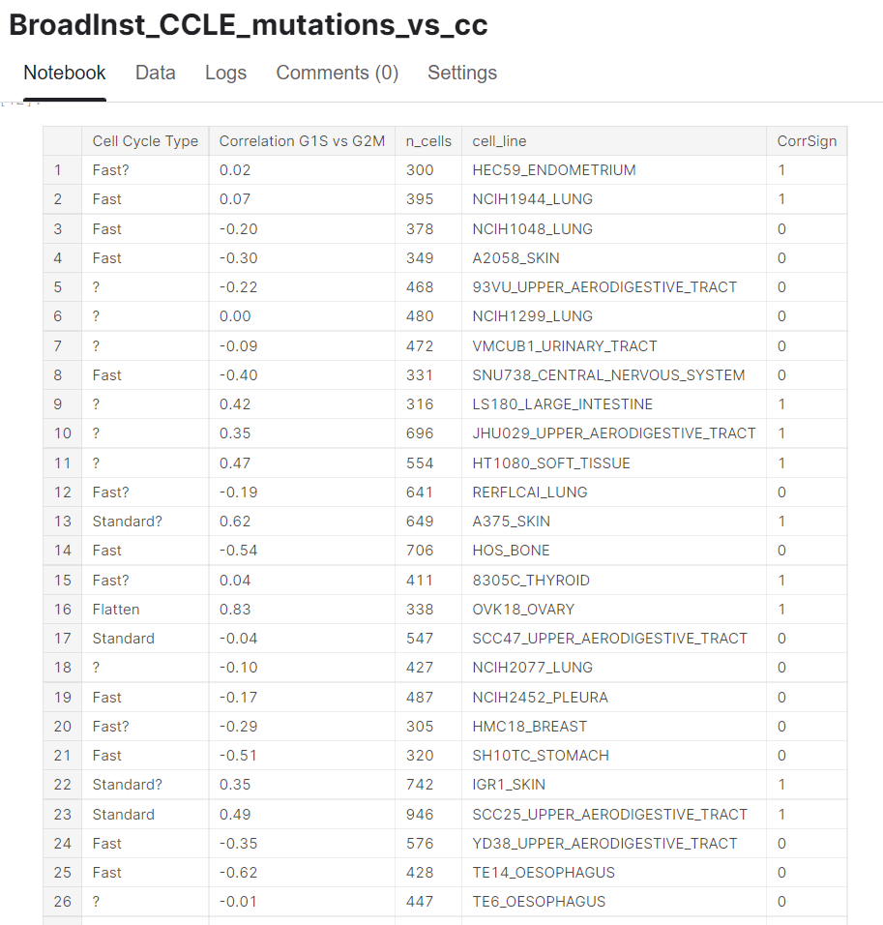
Second claim: fast cc exists for wide range of cancer cell lines, not only for ESC or iPSC.
1 Roughly speaking about half of the 40 cell lines from Broad Institute CCLE (Cancer cell line Encyclopedia) scRNA-seq with high quality shows up “fast cell cycle”
2 Among non cancer cells we see for ESC, iPSC. Suspect for B lymphocytes undergo multiple mitotic divisions, termed clonal expansion. Some 1-2 other cell types, but not more.
Understand what makes some cancer cells to be “fast” is a challenge. We have some partial results.
Notes:
https://www.kaggle.com/code/alexandervc/broadinst-ccle-mutations-vs-cc

Slide 28
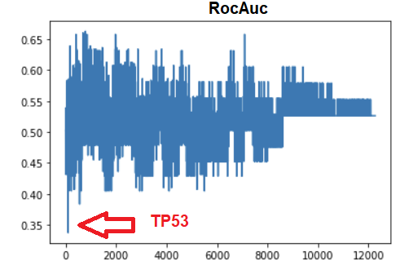
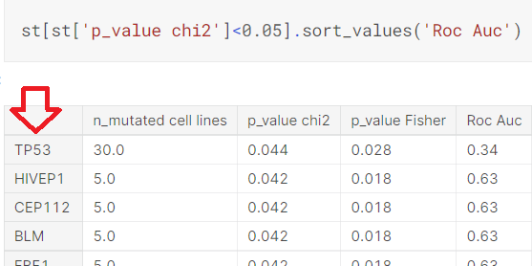
RocAuc, Chi2, Fisher any of these criterias can be used to check whether type of the cell cycle (i.e. binary variable 0,1 (fast/standard) )
Can be predicted by mutation in some gene.
TP53 is strikingly distinguished.
RB1 (retinablastoma gene) does not show up . (It can be expected, but now we cannot confirm it).
There are many other genes, which show dependence, but they will not survive Bonferoni correction.

Slide 29
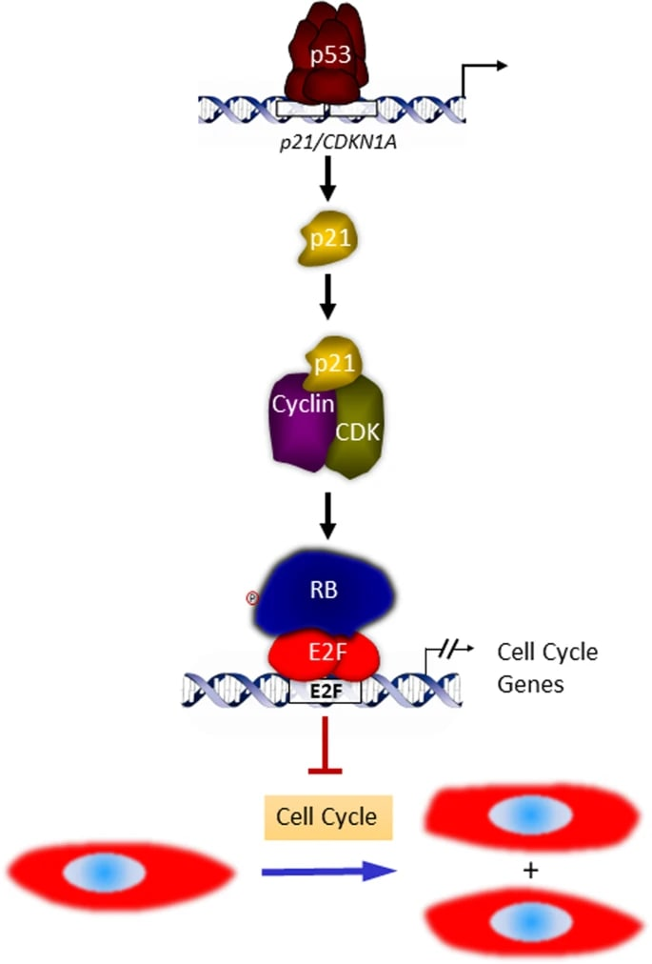
Fifth claim: molecular mechanisms underlying fast cell cycle - candidate: around TP53.
The scheme is clear and consistent with “short” G1 and other observations.
We see correlation between mutation of TP53 and fast cell cycle on CCLE data.
For ESC it is known that TP53 is on the low level
For U2OS TP53 is NOT mutated, but MDM2 is on high level and it is known to block TP53.
Other mechanism are also possible. Better understanding is a - challenge.

Slide 30
Other expected properties of the fast cell cycle.
Absence of R-restriction point.
Cells are committed to the next cell cycle, during the previous one (G2-phase).
G1 part is shortened comparing to standard
mitogen-independent proliferation
Effective reinterpretation of the criteria of “fastness” - G1S is negatively correlated with G2M. It is easy to check it.

Slide 31
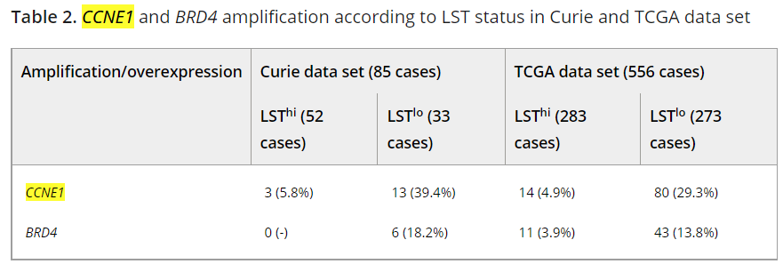
Questions: TNBC related to the “fast” cell cycle ?
High grade ovarian cancer is similar to TNBC and also “fast”?
Motivated by papers [1] “Steroid Hormone Receptors: Links With Cell Cycle Machinery and Breast Cancer Progression” , [2] “Histo-genomic stratification reveals the frequent amplification/overexpression of CCNE1 and BRD4 genes in non-BRCAness high grade ovarian carcinom”, [3] “Integrated Genomic Analyses of Ovarian Carcinoma”
TNBC: [1]: increased levels of Cyclin E, decreasing p73 and p21 expression
HGOC: [2]: activated genes, such as CCNE1 (19q12), MECOM (3q26.2), TPX2 (20q11.21) or inactivated genes, such as CDKN2A (9p21.3), CSMD1 (8p23), DMD (Xp21.1), NF1 (17q12), RB1 (13q14.2) and PTEN (10q23)
"BRD4 is required to maintain Embryonic Stem Cells (ESCs) self-renewal and pluripotency"
Also note that [3]: "These results show that HGS-OvCa is characterized by TP53 mutations in almost all tumors (96%);" [3]
Notes:
`1 https://www.ncbi.nlm.nih.gov/pmc/articles/PMC7994514/
2 https://onlinelibrary.wiley.com/doi/10.1002/ijc.29568
3 https://www.ncbi.nlm.nih.gov/pmc/articles/PMC3163504/

Slide 32
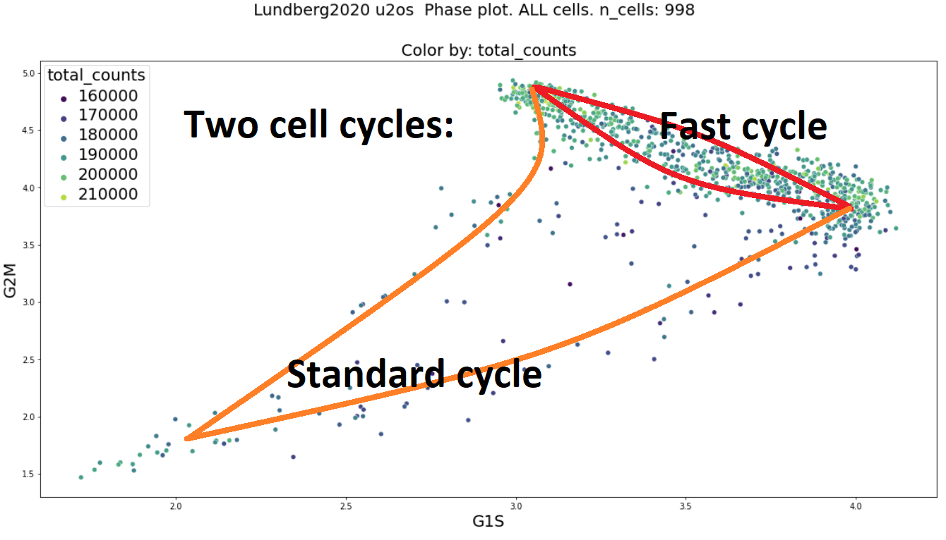
“Two cell cycles within one cell line/type ”
For U2OS cell line (GSE146773) most сells go through the “fast” trajectory, however small minority goes through the “standard” cell cycle.
It is tempting to relate these results to recent studies by Naetar et al. (2014), Spencer et al. (2013 ), Hitomi and Stacy (1999) - reviewed in Matson, Cook (2017) - “live imaging of the fluorescent reporter in single cells revealed the two subpopulations of cells with different Cdk2 activity levels and subsequently different G1 phases” - it was argued that one subpopulation is committed during previous G2 to the next cell cycle which goes through the “fast” G1, while the other part of the cell population goes through the classical cell cycle route with G0 and Restriction point - “long” G1.
Observing two such subpopulations with scRNA-seq technique has not yet been reported before to the best of our knowledge.
Quite striking: TWO modes of the cell cycle may happen within one cell line (one cell population).

Slide 33
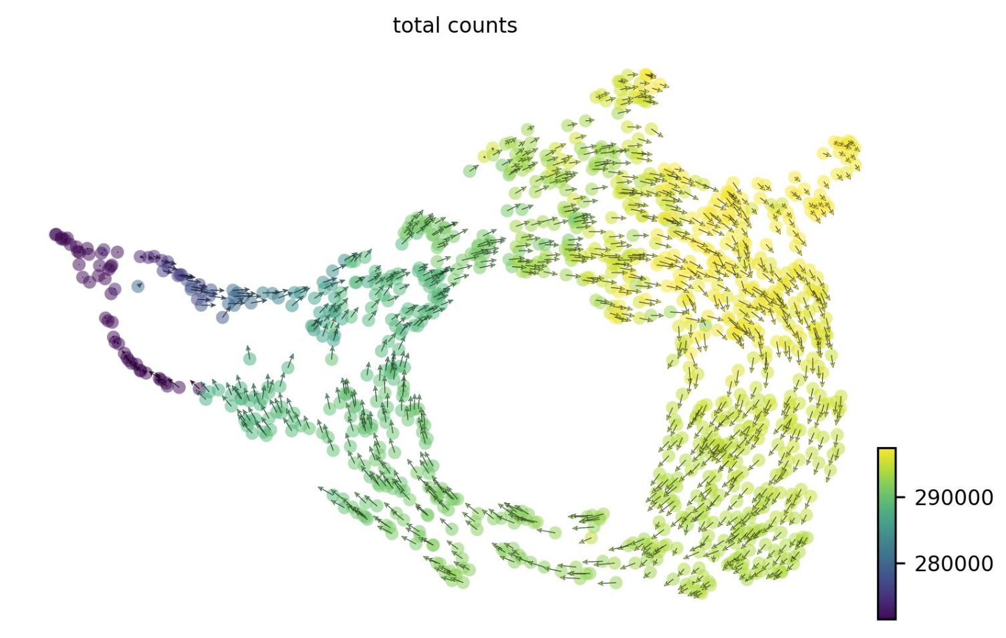
Third claim: even within one cell line, there can be two cell cycle patterns simultaneously ! U2OS example.
To understand what makes some cells go through fast, others through standard cell cycle is a challenge. There are more examples e.g. MCF10-2A
Notes:
There are examples e.g. MCF10-2A
See: https://www.kaggle.com/code/alexandervc/mcf10-2a-p53onoff-cenpa-cell-cycle-01

Slide 34
Thank you !

